Slide 1
HR Attrition Analysis Report
Created By : Jeet N. Trivedi and Learnbay
jeet.n.trivedi05@gmail.com | 9033 444 648

Slide 2
Objective & Business Problem
Subject: Analysis on Employee Attrition Data Analysis
The organization is currently addressing the challenge of employee attrition, leading us to propose a data analysis project using a detailed dataset. The objective is to identify and understand key factors contributing to attrition, enabling strategic measures for effective mitigation. The forthcoming presentation will succinctly outline the business problem, emphasizing the project's goal to uncover insights that inform decision-making and the development of targeted retention strategies, contributing to the long-term success of the organization.

Slide 3
Attrition Analysis
1) What is the overall attrition rate in the company?
The current attrition rate within the company stands at 16.12%, with 237 employees out of a total workforce of 1470 having transitioned during the specified period.

Slide 4
Attrition Analysis
2) Is there a significant difference in attrition rates between different age bands or departments?
Attrition rates differ across age groups:
25 - 34 112
35 - 44 51
Under 25 38
45 - 54 25
Over 55 11
This breakdown highlights age-related trends in attrition, offering valuable insights for further analysis.

Slide 5
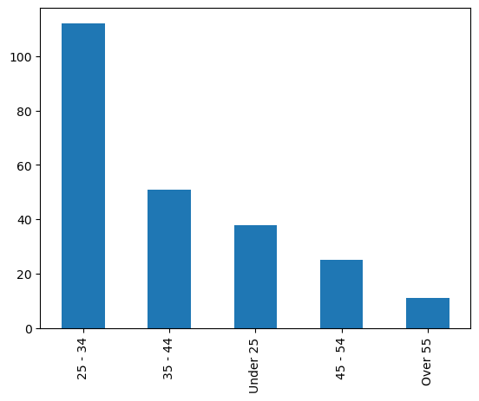
Attrition Analysis
2) Is there a significant difference in attrition rates between different age bands or departments?

Slide 6
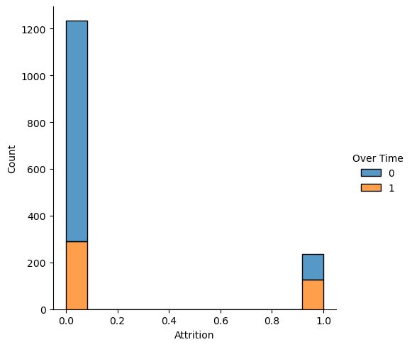
Attrition Analysis
3) Does the presence of overtime have any correlation with attrition?
The data plot underscores a noteworthy trend: 54.27% of departing employees had been assigned overtime duties. This observation suggests a potential association between attrition and overtime responsibilities, prompting a closer examination of the impact of such assignments on employee retention.

Slide 7
Employee Demographic Analysis
1) What is the gender distribution among employees ?
Yes No Total
Male 150 732 882
Female 87 501 588
Total 237 1233 1470
The attrition rate for male employees stands at 17.00%, while female employees exhibit a slightly lower attrition rate of 14.79%. This data provides insights into gender-specific patterns in employee turnover within the organization.

Slide 8
Employee Demographic Analysis
2) Are there any differences in attrition rates based on education fields or levels?
Life Sciences 89
Medical 63
Marketing: 35
Technical Degree: 32
Other: 11
Human Resources: 7
Notably, Life Sciences and Medical fields exhibit higher attrition rates, contributing over 50% collectively. A pie chart further illustrates these disparities, emphasizing the significant impact of these specific fields on the overall attrition rate. This insight suggests the need for targeted retention strategies tailored to the unique dynamics of Life Sciences and Medical roles.

Slide 9
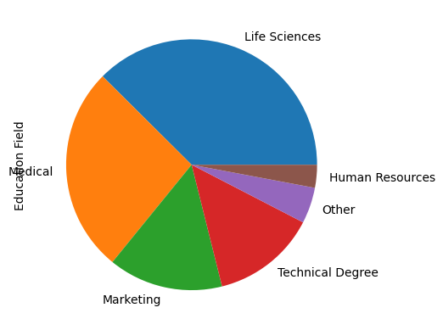
Employee Demographic Analysis
2) Are there any differences in attrition rates based on education fields or levels?

Slide 10
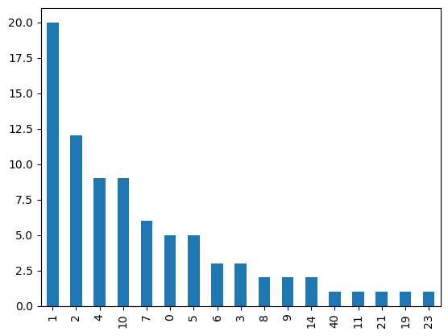
Work Life Balance and tenure analysis
1) Does work-life balance impact the number of years an employee stays with the company ?

Slide 11
Work Life Balance and tenure analysis
1) Does work-life balance impact the number of years an employee stays with the company ?
The depicted plot illustrates the correlation between work-life balance scores and employee attrition. Notably, among the 83 employees with below-average work-life balance scores, 37 opted to resign within 0 to 2 years. This observation strongly indicates a tangible impact on the attrition rate, emphasizing the significance of addressing work-life balance concerns to enhance employee retention.

Slide 12
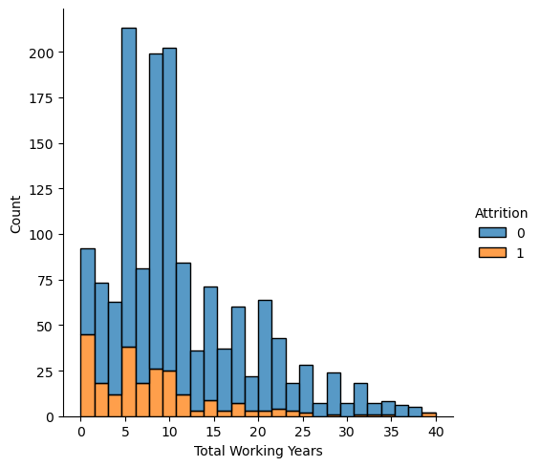
Work Life Balance and tenure analysis
2) Is there any correlation between the total working years and Attrition ?

Slide 13
Work Life Balance and tenure analysis
2) Is there any correlation between the total working years and Attrition ?
The plot suggests that employees with 8–10 years of experience are leaving, possibly due to better opportunities elsewhere or venturing into entrepreneurship after a decade in the industry. Conversely, those with 20+ years of experience are likely retiring, choosing a peaceful transition from work life.

Slide 14
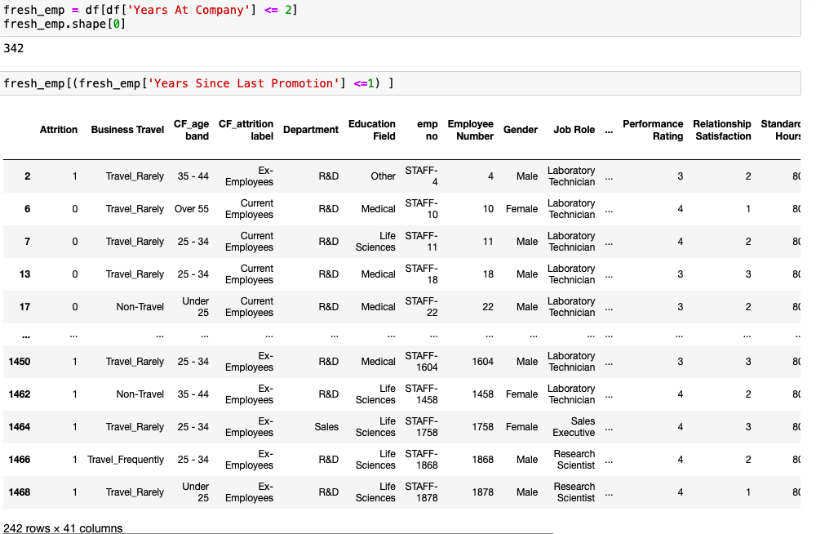
Promotion and Career Development
1) Are the employees who stay longer at company are more likely to get promoted ?

Slide 15
Promotion and Career Development
1) Are the employees who stay longer at company are more likely to get promoted ?
A noteworthy observation indicates that 242 out of 342 employees (70%) who joined the company within the last 2 years have received promotions. This implies a proactive focus on recognizing and rewarding the performance of new employees. The data suggests that those demonstrating commendable performance in their early tenure are being duly acknowledged and promoted within the organization.

Slide 16
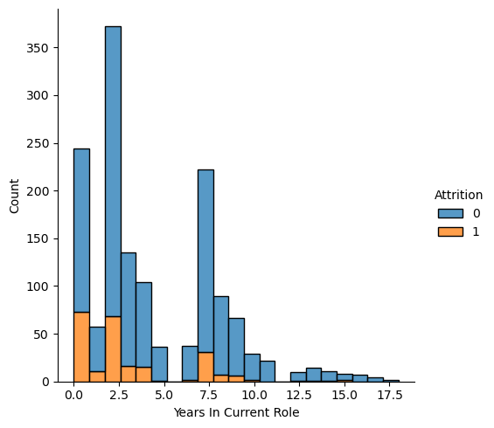
Promotion and Career Development
2) Dose no. of years in current role affects attrition ?

Slide 17
Promotion and Career Development
2) Dose no. of years in current role affects attrition ?
The bar plot reveals distinct spikes at years 0, 2, and 7.5 in the number of years in the current role, indicating a trend of employees seeking new positions approximately every two years. Notably, employees who recently acquired a new role and subsequently left may not have found satisfaction in their updated job responsibilities. The observation at 7.5 years suggests that prolonged periods in the same role may contribute to attrition, aligning with expected career progression.

Slide 18
Department Analysis
1) Is there any department with higher and lower attrition rate?
Attrition rates differ across departments :
R&D 133
Sales 92
HR 12

Slide 19
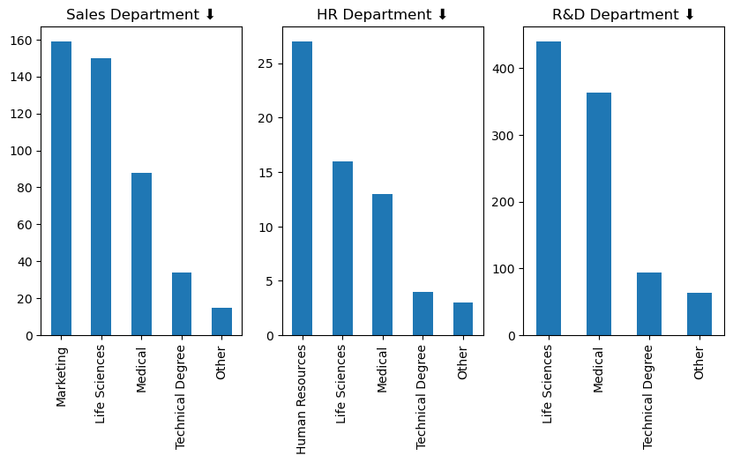
Department Analysis
2) are there any trends between education level and department?

Slide 20
Department Analysis
2) are there any trends between education level and department?
The charts illustrate that a significant majority of employees within each department possess educational backgrounds that align closely with the respective requirements of their roles.

Slide 21
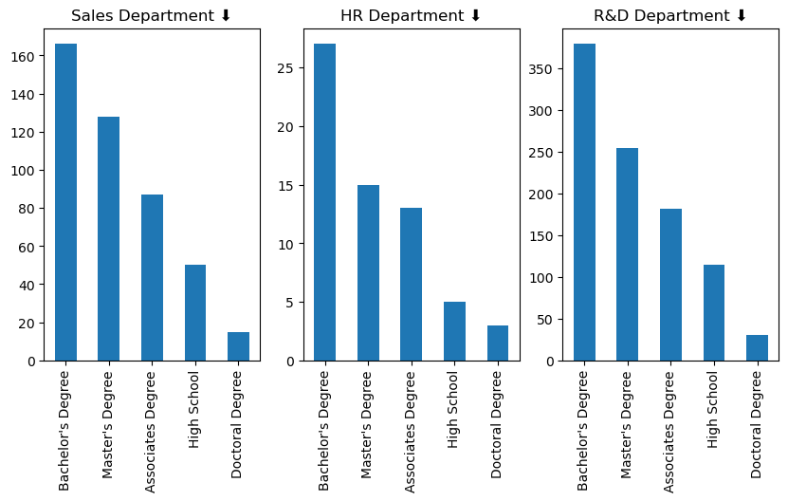
Department Analysis
2) are there any trends between education level and department?

Slide 22
Department Analysis
2) are there any trends between education level and department?
In each department, the dominant educational qualification among employees is a bachelor's degree, closely followed by those with master's degrees.

Slide 23
Work Environment and Job Satisfaction
1) How does work environment affects job satisfaction and causes attritions ?
Environment Satisfaction of employees
who have quit the company.
1 72
3 62
4 60
2 43
Job Satisfaction of employees who have quit the company
3 73
1 66
4 52
2 46

Slide 24
Work Environment and Job Satisfaction
1) How does work environment affects job satisfaction and causes attritions ?
Upon closer examination, it has been observed that among the employees who have resigned from the company, 72 individuals reported an environment satisfaction score of 1, while 66 employees expressed a job satisfaction score of 1 point. Out of the total 237 employees who have left the company, 58 of them had both job and environment satisfaction ratings at or below 2 points.

Slide 25
Work Environment and Job Satisfaction
2) Is there any relationship between job involvement and attrition?
Job Involvement of employees who have quit their jobs.
3 125
2 71
4 28
1 13
Job involvement of employees
3 868
2 375
4 144
1 83

Slide 26
Work Environment and Job Satisfaction
2) Is there any relationship between job involvement and attrition?
Job Involvement of 4 and % of employees who have quit their jobs : 9.027 %
Job Involvement of 3 and % of employees who have quit their jobs : 14.40 %
Job Involvement of 2 and % of employees who have quit their jobs : 18.93 %
Job Involvement of 1 and % of employees who have quit their jobs : 33.73 %
The data indicates that employees with a job involvement rating below 3 are more prone to resign, with approximately 52% of those who have quit scoring below 3 in job involvement.

Slide 27
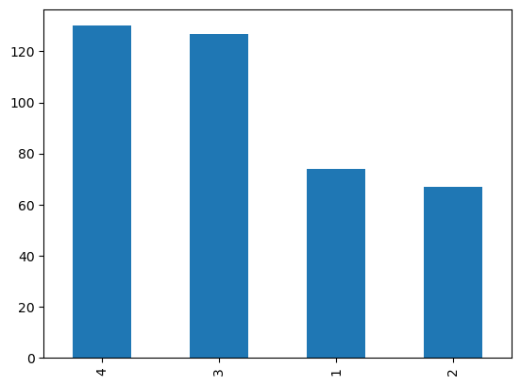
Performance VS Education
1) Do employees with higher education perform higher and have higher job satisfaction
4 130
3 127
1 74
2 67

Slide 28
Performance VS Education
1) Do employees with higher education perform higher and have higher job satisfaction
Indeed, employees with advanced education degrees exhibit high job satisfaction, consistently assigning satisfaction points of 3 or 4.

Slide 29
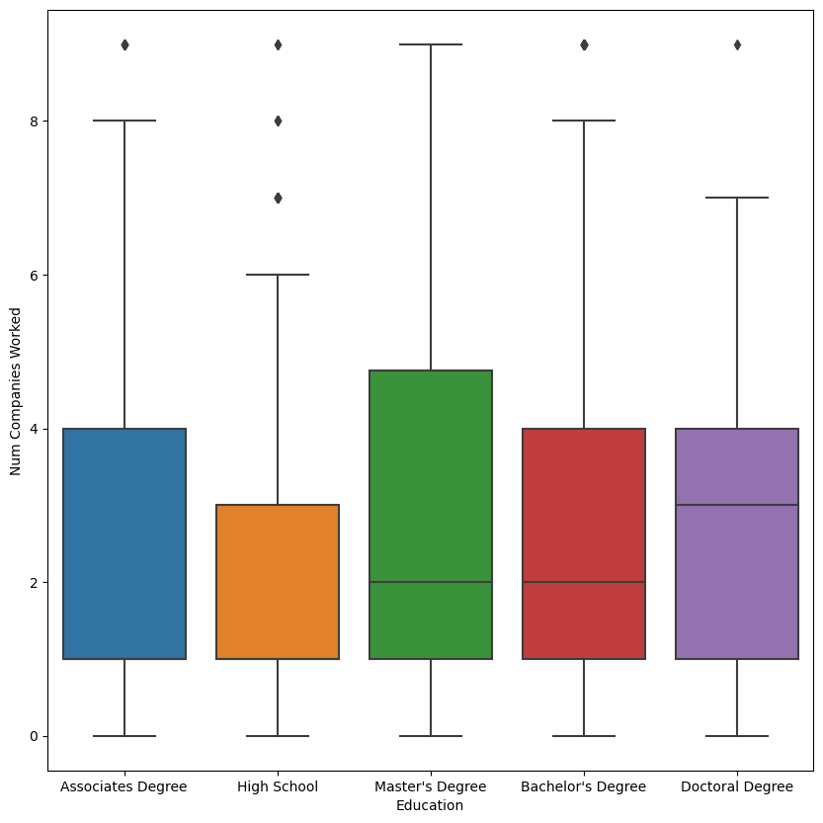
Performance VS Education
2) How education level affects no. of year employees work at company ?
Count of emp by education level
Bachelor's Degree 572
Master's Degree 398
Associates Degree 282
High School 170
Doctoral Degree 48

Slide 30
Performance VS Education
2) How education level affects no. of year employees work at company ?
Based on the findings, employees with lower education levels, such as those with high school qualifications, tend to stay longer, possibly due to limited expertise and ambition. Conversely, individuals with master's and bachelor's degrees are more inclined to switch companies, leveraging better job portals, connections, and a desire for continuous learning in their field of expertise.

Slide 31
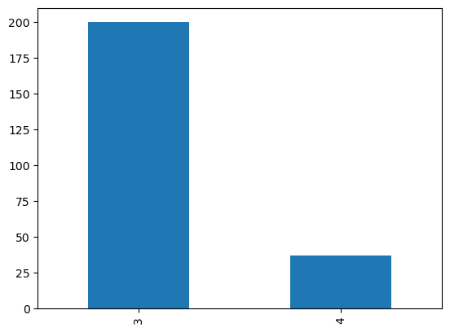
Employee Performance & Satisfaction
1) Is there any relation between performance and attritions?
Based on the observation, it appears that employees with a performance rating of 3 are more prone to resigning from their positions.

Slide 32
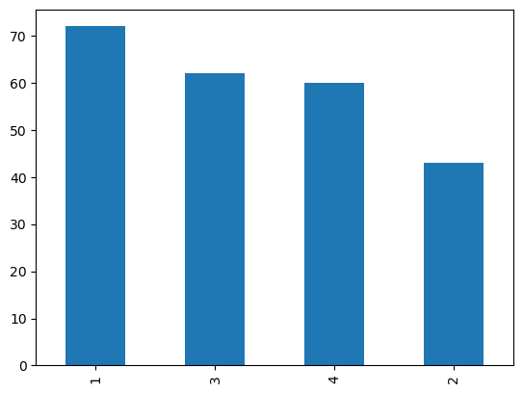
Employee Performance & Satisfaction
2) How does employee satisfaction impact attrition ?
Environment Satisfaction

Slide 33
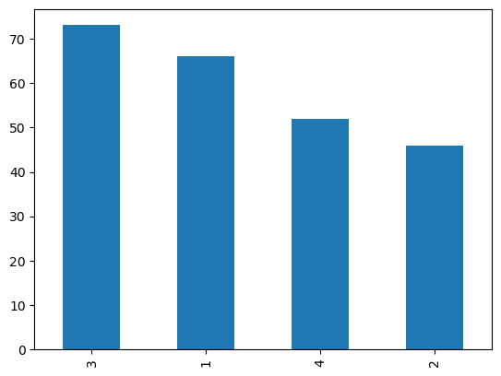
Employee Performance & Satisfaction
2) How does employee satisfaction impact attrition ?
Job Satisfaction

Slide 34
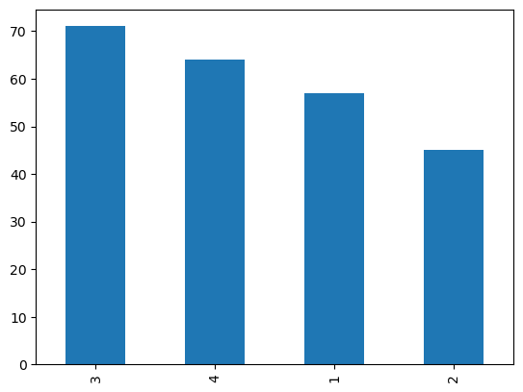
Employee Performance & Satisfaction
2) How does employee satisfaction impact attrition ?
Relationship Satisfaction

Slide 35
Employee Performance & Satisfaction
2) How does employee satisfaction impact attrition ?
Based on each observation, it is evident that employees with a satisfaction level of 3 are more inclined to consider resigning from their roles within the company.

Slide 36
Job Role Analysis
1) Which job roles has highest and lowest attrition rates ?
Among the various job roles, Laboratory Technicians exhibit the highest attrition rate, with 62 individuals leaving their positions. On the positive side, the Research Director role boasts the lowest attrition rate, with only 2 departures. This data underscores the notable discrepancy in attrition rates across different job roles, emphasizing the need for targeted retention efforts, particularly in roles with higher turnover.
Laboratory Technician 62
Sales Executive 57
Research Scientist 47
Sales Representative 33
Human Resources 12
Manufacturing Director 10
Healthcare Representative 9
Manager 5
Research Director 2

Slide 37
Income Analysis
1) How does monthly income and hikes influence attrition ?
The average monthly income for current employees in the company stands at $6832.7 In contrast, those who have resigned received an average salary of $4787.0 This notable discrepancy in average salaries can provide valuable insights for the company.
6832.7
4787.0

Slide 38
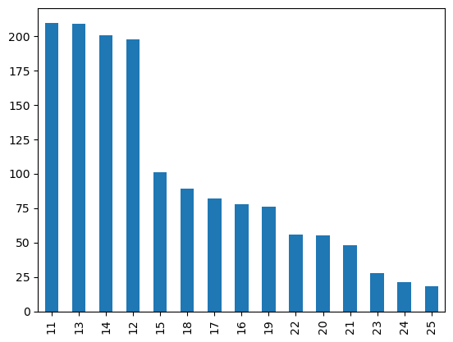
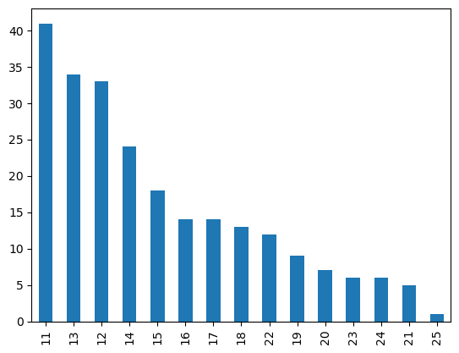
Income Analysis
1) How does monthly income and hikes influence attrition ?
Attrition = No
Attrition = Yes

Slide 39
Suggestions
Role-Specific Focus: Address high attrition rates in roles like life science and medical staff.
Work-Life Balance: Enhance work-life balance and reduce overtime rates across the organization.
Job Involvement Workshops: Implement workshops to boost job involvement among employees.
Open-Ended Meetings: Conduct open-ended meetings, particularly in departments with higher attrition like sales and R&D, to gather employee opinions.
Enhance Work Environment and Salaries: Make incremental improvements to the work environment and consider adjustments to monthly income.
Follow-Up Surveys: Plan periodic employee surveys to track progress and gather ongoing feedback for continuous improvement.

Slide 40
Suggestions
Role Change Follow-Ups: Initiate follow-ups after role changes, recognizing the impact of tenure in current roles on attrition. Address any dissatisfaction promptly.
Exit Interviews for Insights: Conduct exit interviews to analyze specific reasons cited by departing employees. Understand their expectations and identify areas where the company fell short, informing future retention strategies.

Slide 41
Thank you very much.
Your Questions or Feedback ?

